Slide 1
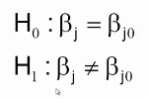
Test on Individual Regression Coefficients
The Hypothesis test may be conducted on regression coefficients to see whether their value is indeed their predicted value or they are different.

Slide 2

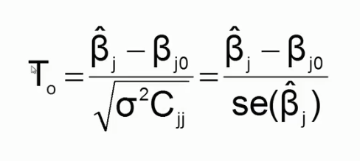
Test on Individual Regression Coefficients
Here C_{jj} is the diagonal element of the var-covar matrix (X^{T}X)⁻¹ corresponding to B_{j .}

Slide 3
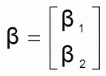
Test on Subset of Coefficients
Rather Than Carrying out this test one regression coefficient at a time, We may do it for a subset of the coefficients in one go. Let us consider the partitioning of the regression coefficients into two vectors

Slide 4
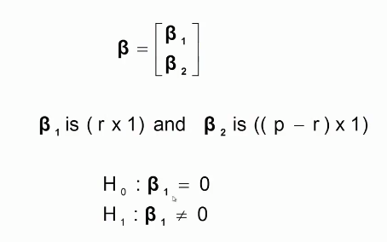
Extra Sum of Square Method

Slide 5



Full Model

Slide 6


Extra Sum of Squares Method
To find the contribution of the terms in B₁ to the regression , fit the model assuming the null hypo is true. Then the reduced model is
The coefficients of the reduced model may be found as

Slide 7
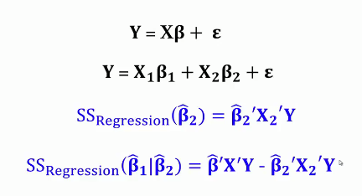
Extra Sum of Squares Method

Slide 8

Extra Sum of Squares Method

Slide 9
THANK YOU

